Slide 1

Cyclistic Presentation Analyzing customer types and behaviors
Adam Ben-Kiki
Data Analyst
September-22

Slide 2
Company Strategic goal:
Design marketing strategies aimed at converting casual riders into annual members
My Main Task:
How do annual members and casual riders use Cyclistic bikes differently?

Slide 3
ASK:
My initial questions that guided me were: Who is using our services?
Social-economic status
age
Why are they using our services?
For business or pleasure?
How are they using our services?
On what days, seasons of the year
How often?

Slide 4


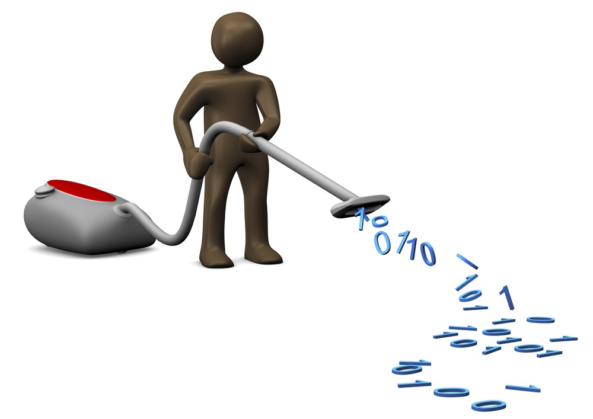
Data preparation and cleaning
I’ll try to make this boring part quick

Slide 5
Preparing & Cleaning
I connected to 12 main CSV files containing one whole year of Cyclistic’s data. This resulted in 5.6 million rows. For this I chose Power BI as my main ETL and model builder tool.
Created a Duration column.
Removed all NULL Station IDs
Created a Flag column to filter out more defective data
The process resulted in reliable clean data of 4.4 million rows

Slide 6
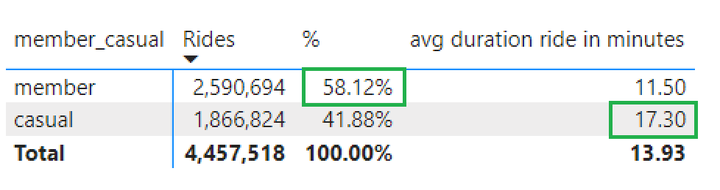
Plain Stats
Most of our rides are from our annual members with ~60% of total rides however our casual members ride for a longer duration of time (17 minutes avg).

Slide 7
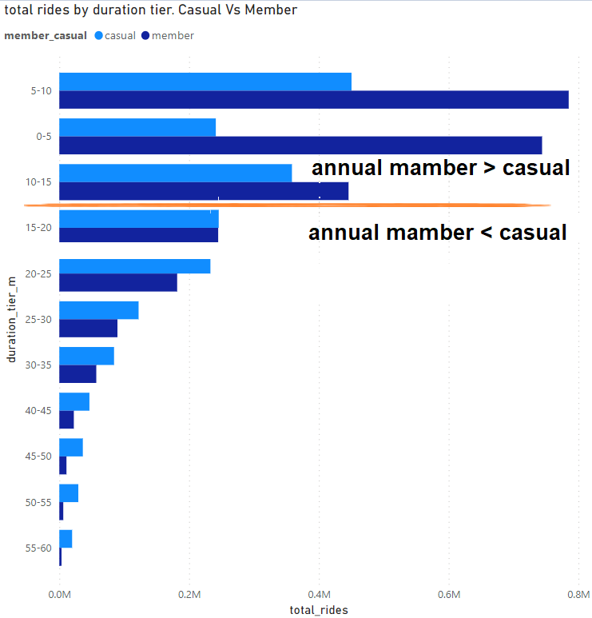
Our annual members are getting extra value from short distance rides and our casual members require longer rides.
But to where? For what purpose? on what days? with what type of bike?

Slide 8
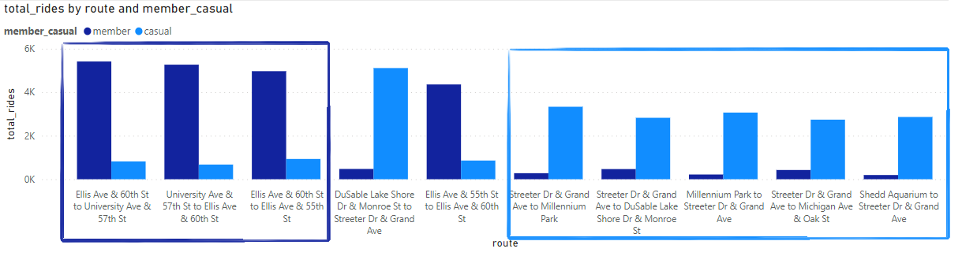
Popular Routes
This observation leads me to believe that our annual members are either student / Uni faculty or blue-collar workers just starting their carrier and our casual members are observers new to the tech and tourist.

Slide 9
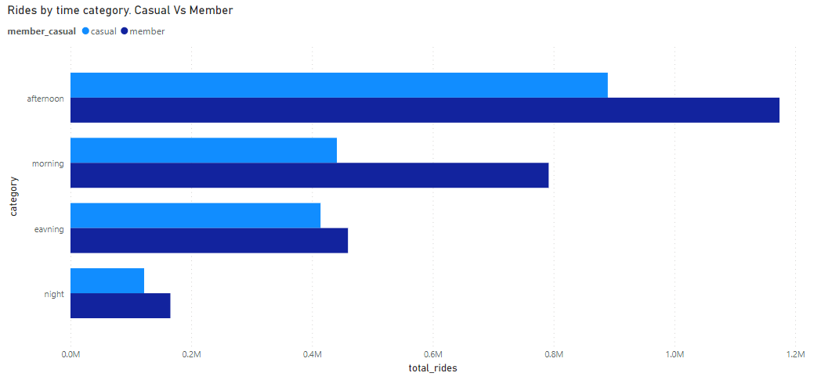
Popular Time Of Day
For both our users, the afternoon is the time when they use our services the most

Slide 10
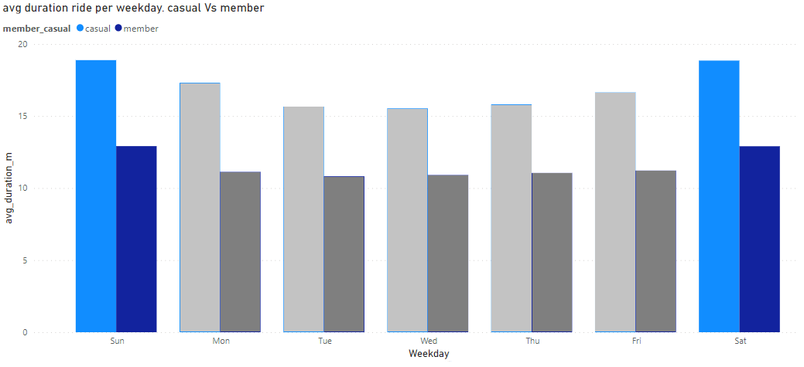
Popular Days and Seasons
Our annual members have a fixed route they use daily when our casual members route vairy.
But for both users, the weekend is preferable

Slide 11
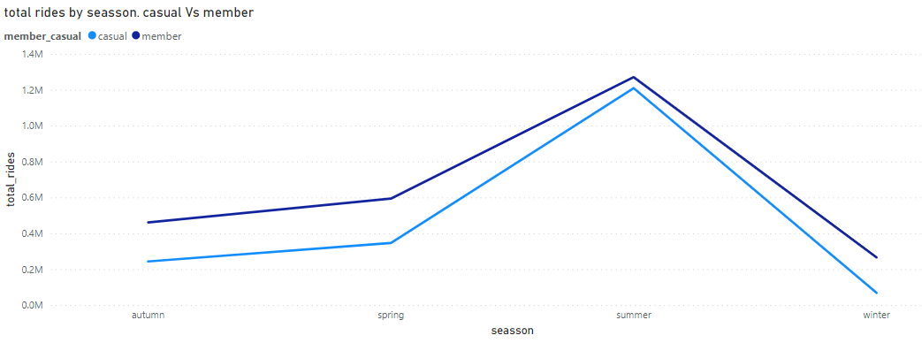
Popular Seasons
Our annual members have a fixed route they use daily when our casual members route vairy.
But for both users, the weekend is preferable

Slide 12
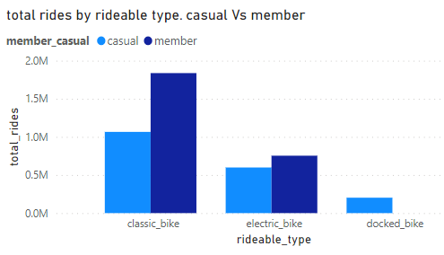
Rideable Types
It is worth noting that our annual members do not use the docked bikes at all.

Slide 13
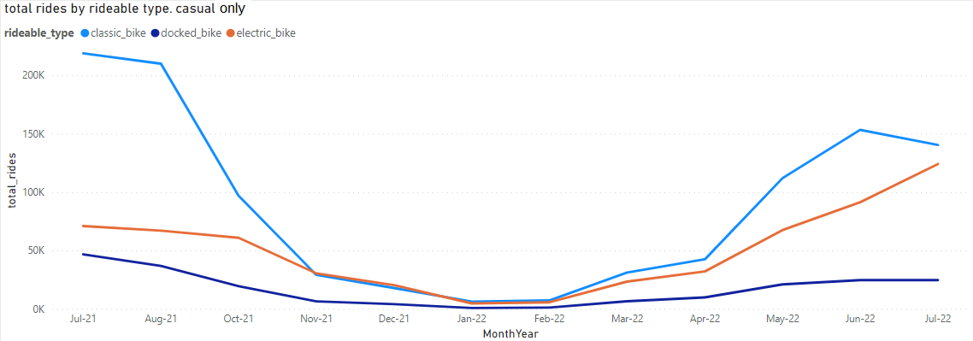
Rideable Types over time
Annual members don’t have a preferable bike type over time.
Casual members prefer the electric bike during the winter. Most likely to dodge the snow and rain.
Electric Bikes > Classic Bikes

Slide 14
Meet Our Annual & Casual Members
Most likely to convert!
Anna
Annual Student
Allaman
Annual Blue-Collar Worker
Sam
Casual Tourist
Jessica
Casual acting as Annual Student
BC Worker
New to the city

Slide 15
Insights & Actions to take
Insight
Insight
Insight
Annual members are students / new blue-collar workers trying to commute to work/Uni in a fixed fast, accessible, and low-cost way.
Causal members travel to popular touristy places sightseeing the city (hence the long travel time). These customers won't comply to our objective.
There’s an outlier of casual customers that act like annual members. Such as new students, new residence and overall leads unaware of our Annual plan.
These are the prospectors we need to tackle to convert them into annual members.
Our busiest time for both types of members are during the summertime weekends in the afternoon with the classic bike being our most popular product followed by our electric bike

Slide 16
Insights & Actions to take
ACT
ACT
ACT
Collaborate with universities and boost annual memberships for students and faculty. The students will most likely keep using our services long after they finish their studies and faculty members will use our services as well.
Target users that ride under 15 minutes to raise awareness on the benefits on becoming an annual member Via social media
As well as an overall awareness campaign during the weekend summertime
Consider removing Docked Bikes from the company for almost no one uses them
During the winter, add more electric bikes to be used for Annual members only

Slide 17
Thank You
Adam Ben-Kiki
Data Analyst
linkedin.com/in/adam-ben-kiki
github.com/AdamBK100
Adambk486@gmail.com

